Slide 1

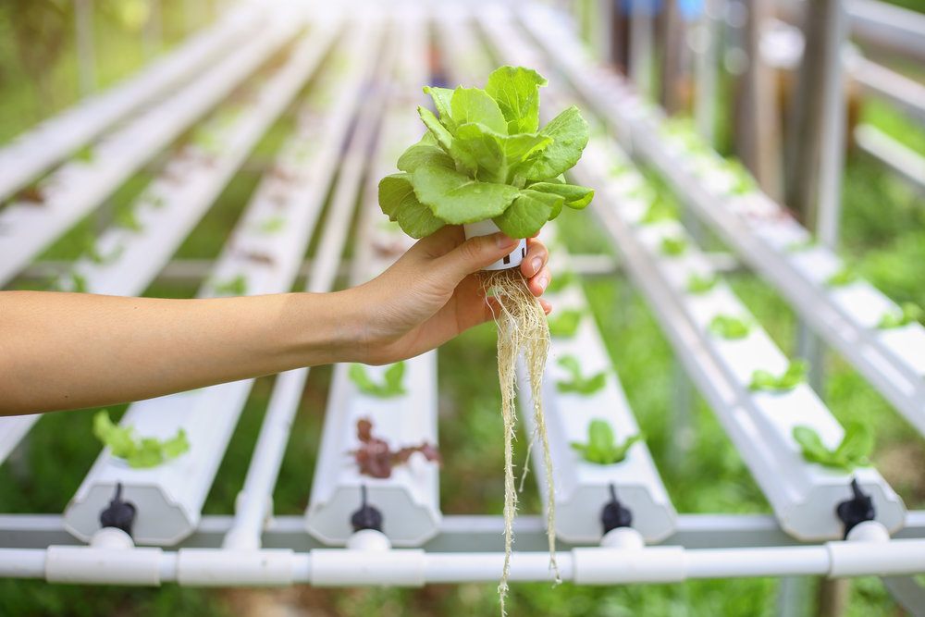
IOT system
for
hydroponic farming
Sina Gholami, Emilio Paolini, Federica Verna

Slide 2
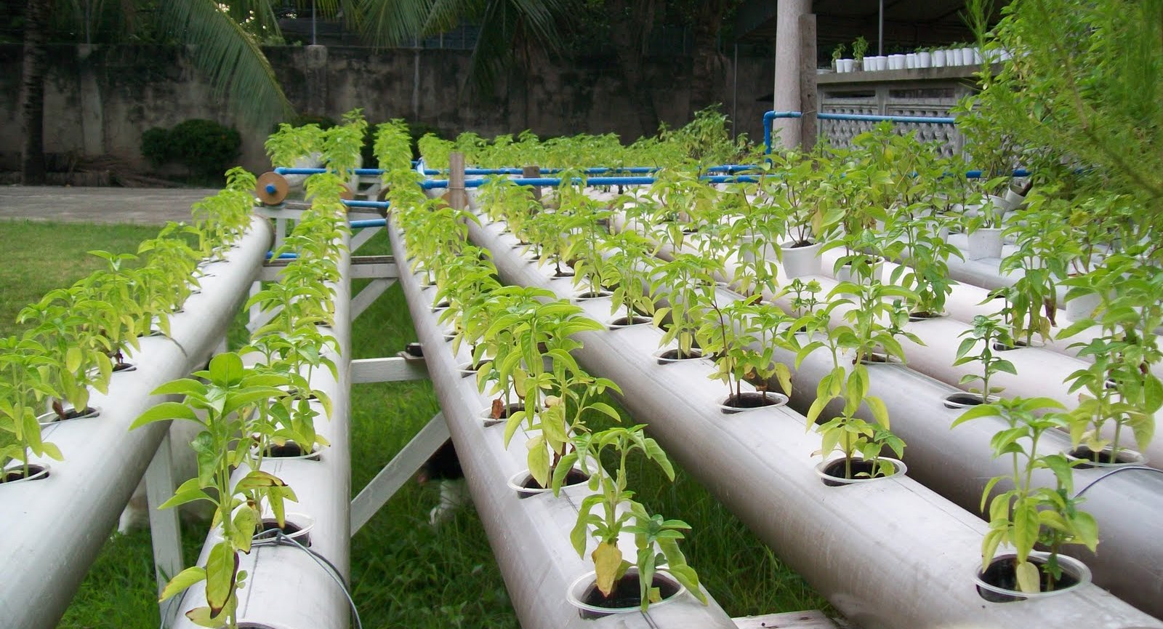
Hydroponic farming
A Hydroponic System is a system of growing crops without soil, where the plant roots grow in nutrient-rich water.
It requires continuous monitoring and attention in terms of:
Oxygen
Light
Nutrients: Minerals and PH

Slide 3

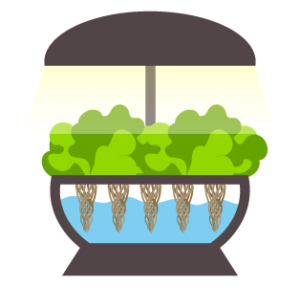

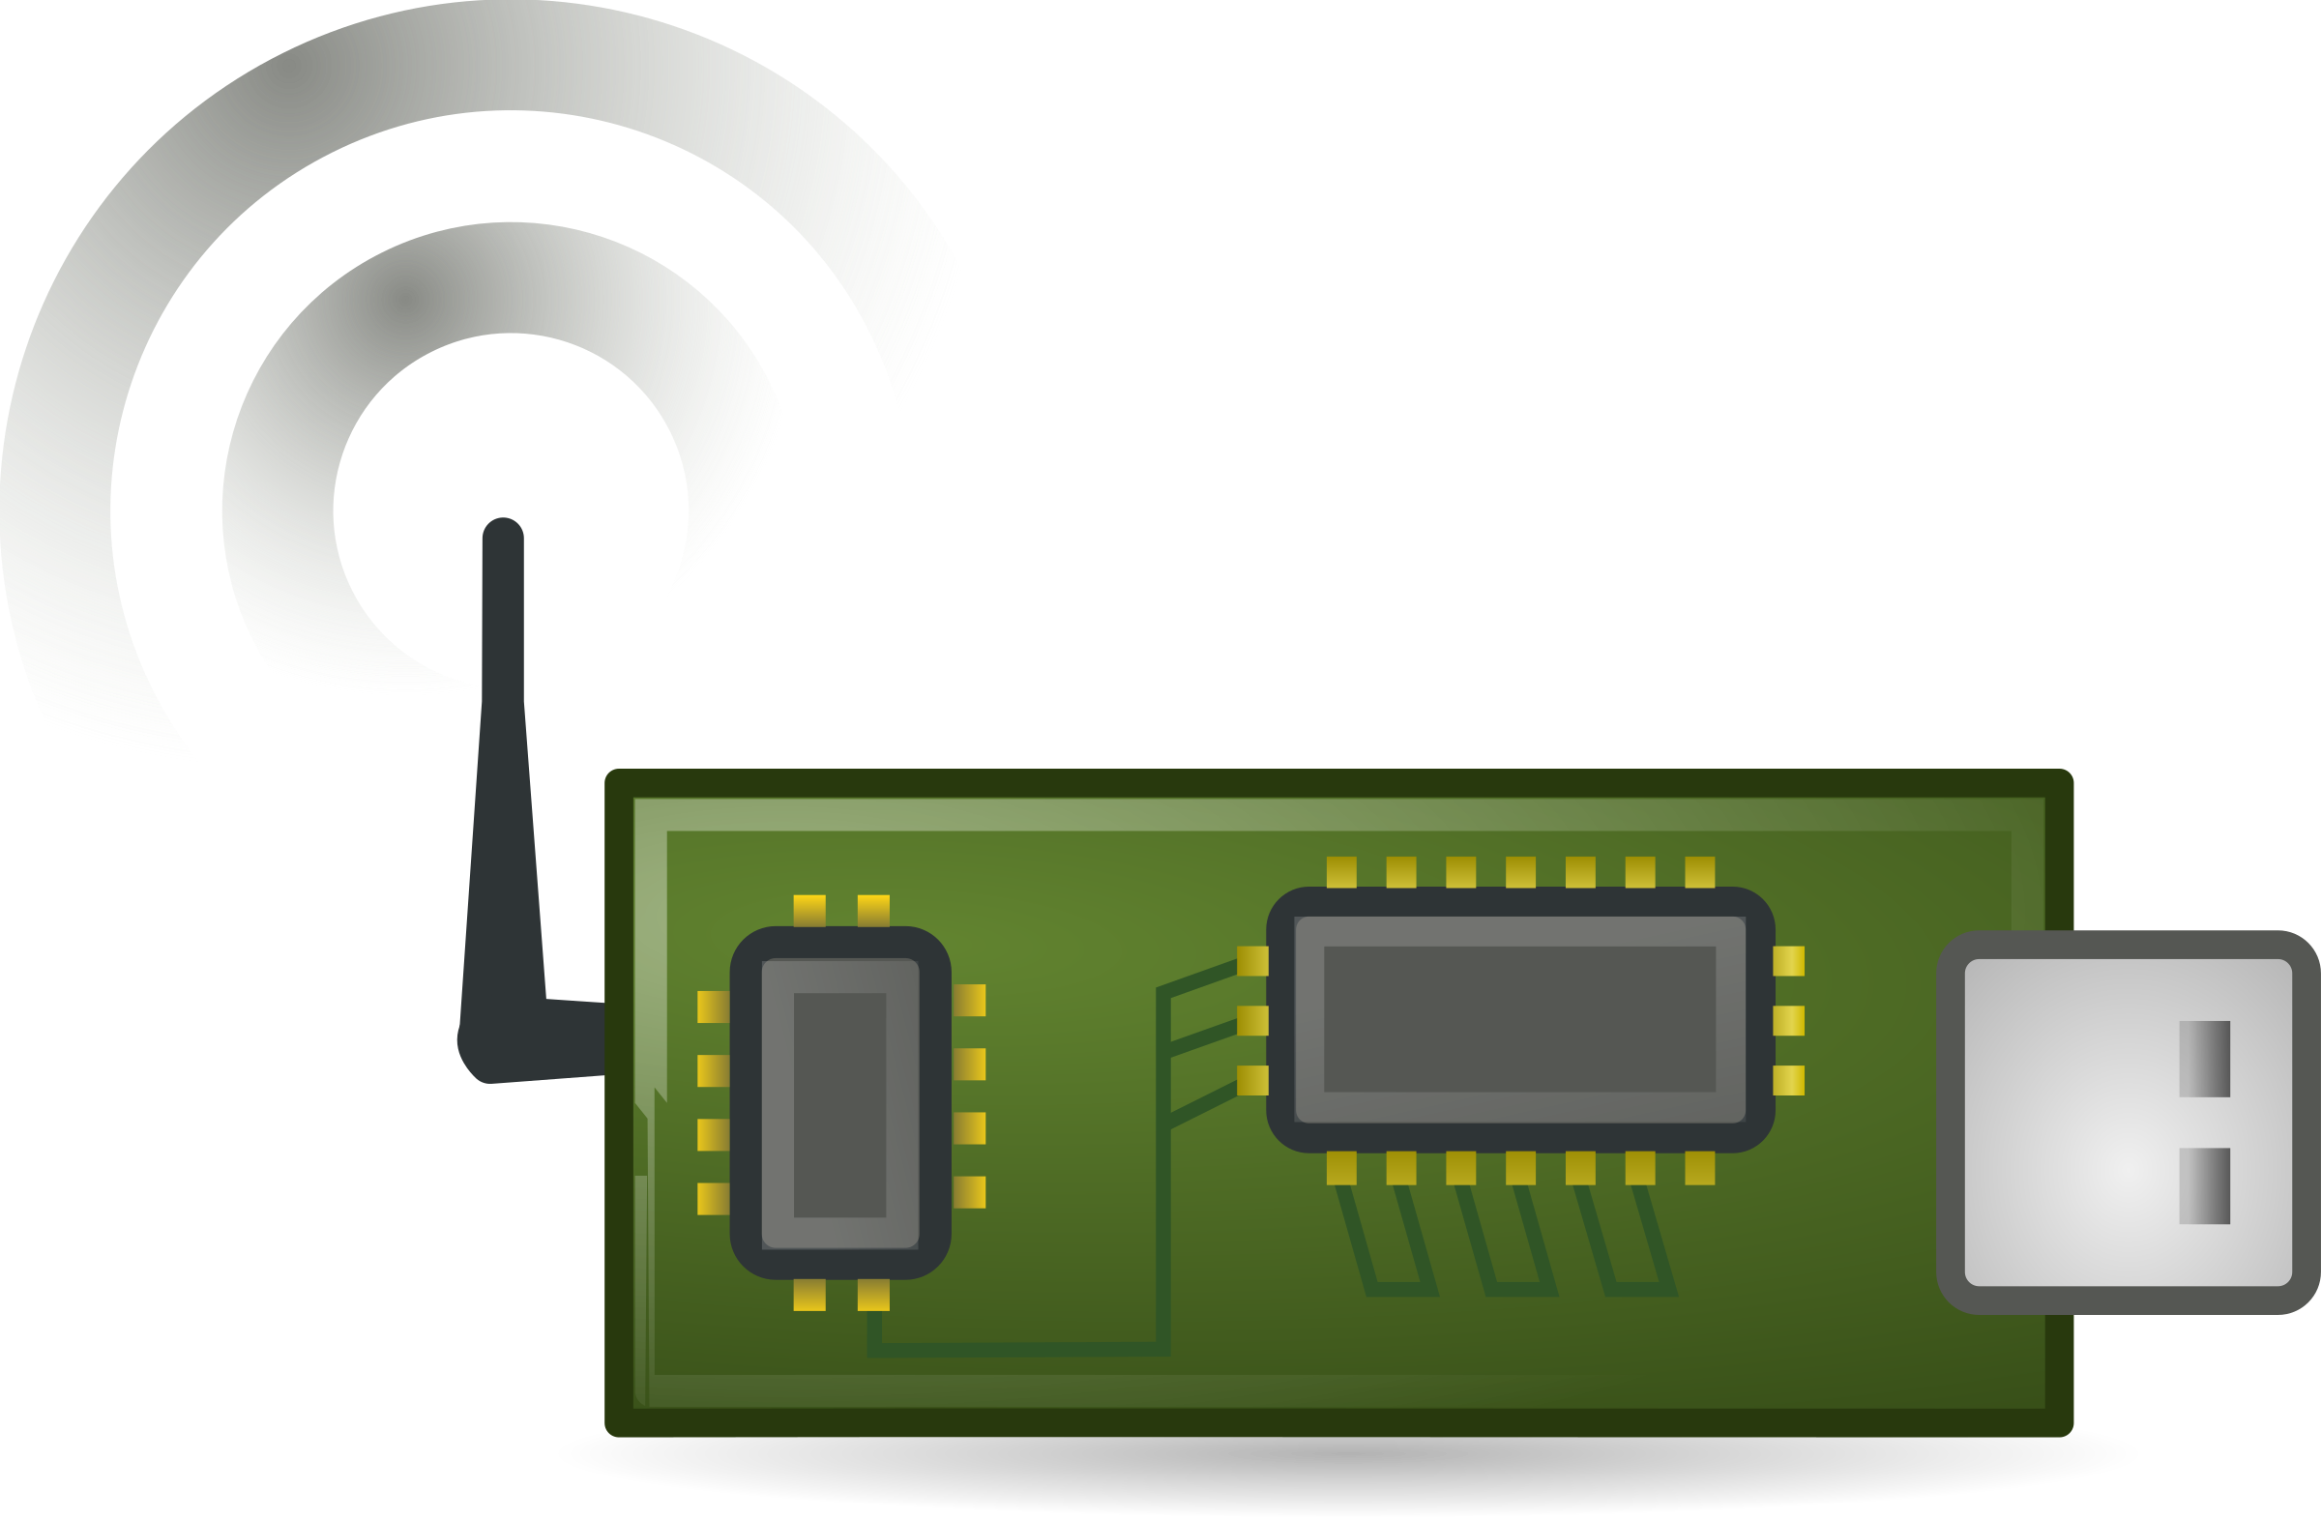

IOT System
Light sensor
Light actuator
Border router
Oxygen actuator
Cloud application
Oxygen sensor
Minerals sensor
Ph sensor
Water actuator

Slide 4




Technologies
ContikiNG OS
Californium
MySQL
Spring Framework
Open-source OS for Next-Generation IoT devices.
It focuses on low-power communication and standard protocols.
Open-source implementation of CoAP written in Java and targets unconstrained environments such as back-end service infrastructures and less constrained environments.
MySQL Database is a database service to deploy cloud-native applications.
Framework providing a comprehensive programming and configuration model for modern Java-based enterprise applications.

Slide 5
Nodes
Sensor
Actuator
Provides a CoAP resource
Sensing values are decreased/increased according to assigned actuators status
Sensing values are shown in the cloud application
Button to force acquisition of new data from the environment
Provides a CoAP resource
Observes the sensor resource
Green, Yellow and Red LEDs to represent the critical levels

Slide 6


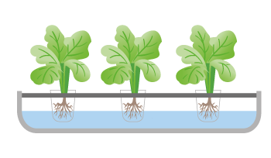


How the system works
Cloud Application
The cloud application pulls the updated values every second
Server
The server monitors the states of registered nodes
Actuator
Actuators observe the associated sensors using machine-to-machine interaction and decide to turn off or on
Sensor
Sensors measure the oxygen, light and nutrients values

Slide 7
System workflow
Sensors & Actuators deployment
Sensor discovery
By the actuator
Running time
Sensors & Actuators registration
to the server
Actuator registration as observer
Monitoring through Cloud Application dashboard

Slide 8
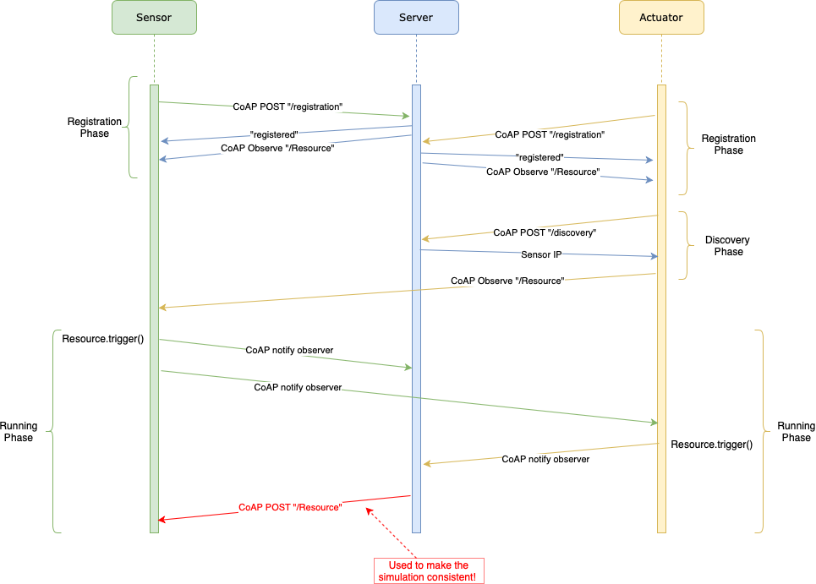
Exchanged messages

Slide 9
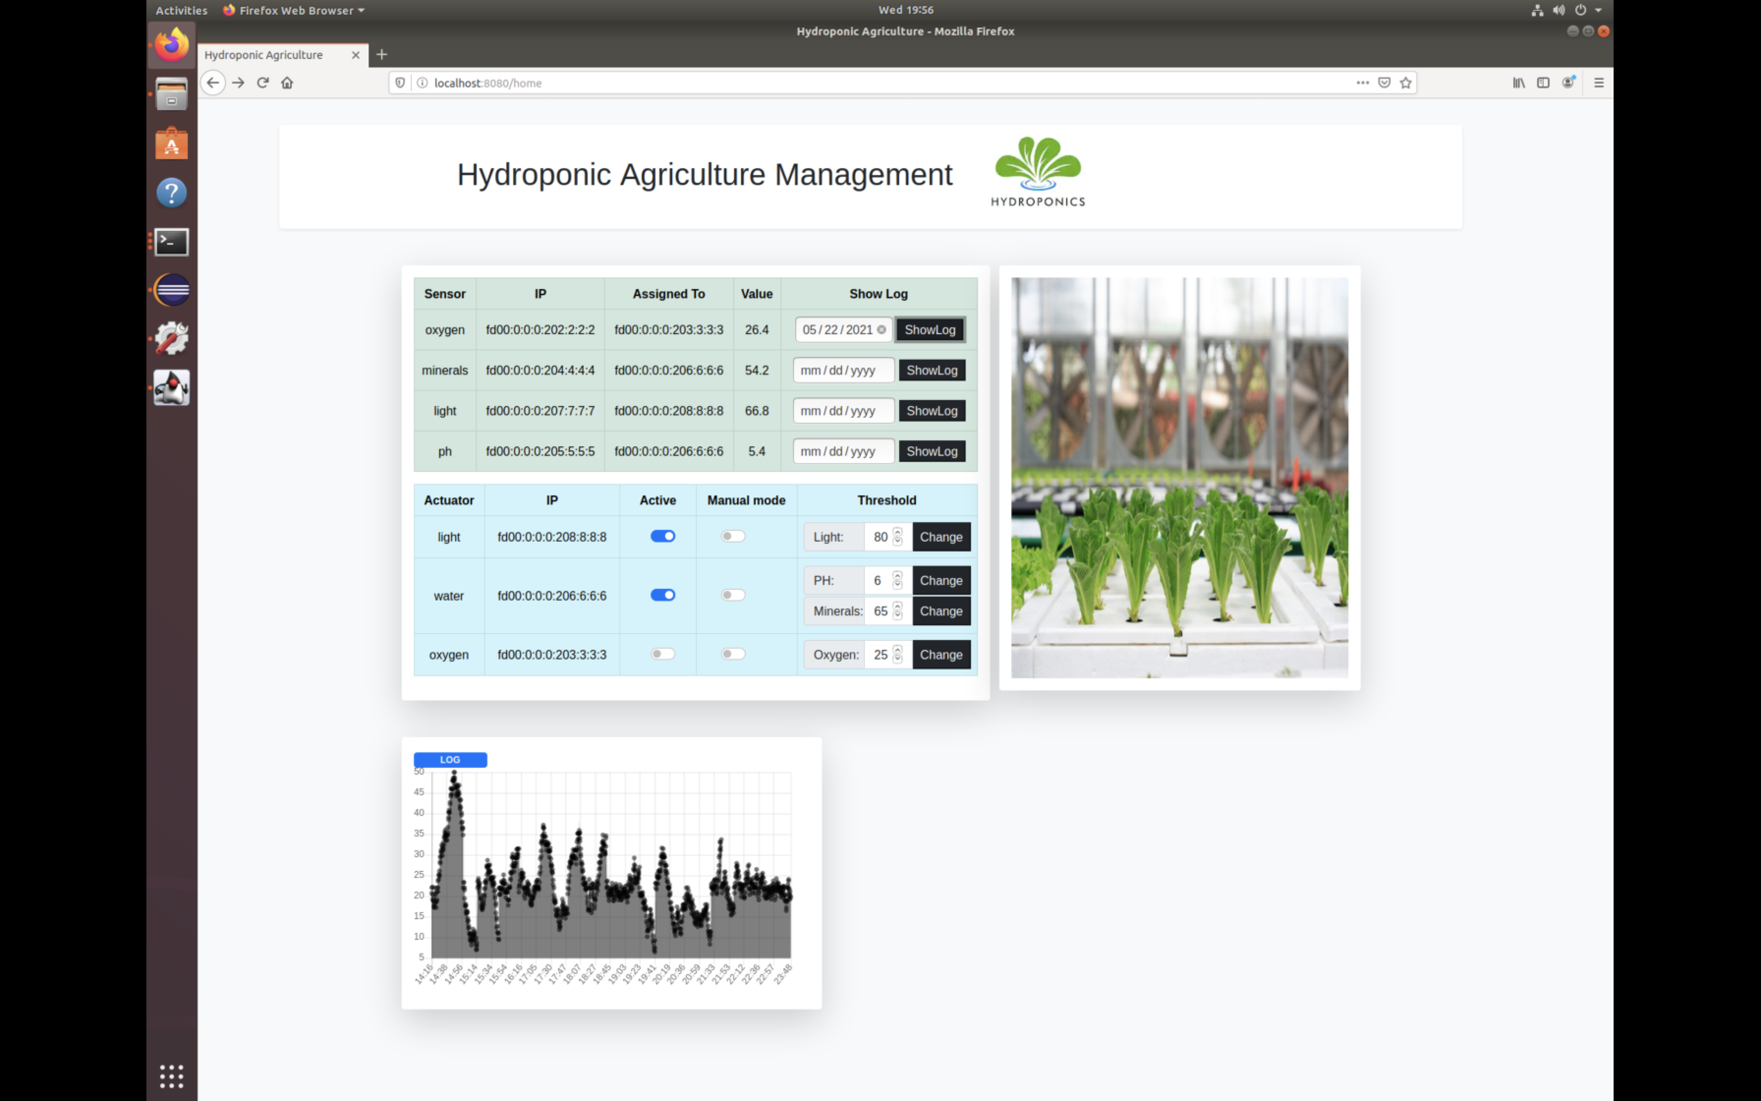
Cloud application
Sensors description with name, IP, Assigned actuator and Value
Actuators description with name, IP, Status, Manual Mode and Threshold
Threshold selection
Log chart of the selected date
Manual mode: when set, the actuator will ignore the values from the sensor to decide its status

Slide 10
Hydroponic
Thank You
for the attention

